Slide 1

Smart Phone Price Prediction

Slide 2
CONTENT
1. INTRODUCTION
2. PROBLEM STATEMENT
3. DATA PREPROCESSING
4. MODEL DEVELOPMENT
5. MODEL EVALUATION
6. VISUALIZATION
7. CONCLUSION

Slide 3
INTRODUCTION
Mobile now a days is one of the most selling and purchasing device. Mobile phones come in all sorts of prices, features and specifications.
Price is the most important component in the marketing of any product and is often the definitive factor in its sale to a consumer.
Every day new mobiles with new version and more features are launched. Hundreds and thousands of mobile are sold and purchased on daily basis.
Deciding on the correct price of a smartphone is very important for its market success.

Slide 4
PROBLEM STATEMENT
The data contains information regarding mobile phone features, specifications and their prices. In this project, we will analyze the specifications of smartphones and predict their prices.
The aim is to build a model that can be used for predicting the price of a smartphone with desired features and specifications.
A tool that gives the estimated price of a smartphone after weighing in the features it provides can come in handy and can help the company in making an informed decision while setting its market price.
Such a tool can also be used by a consumer to get an estimated price based on the features they are looking for in the smartphone.

Slide 5
DATA SOURCE
The Mobile Specifications and Prices dataset sourced from the Kaggle data science community website (https://www.kaggle.com/datasets/pratikgarai/mobile-phone-specifications-and-prices?resource=download) that shows the price of smartphones was used to train the prediction model. The dataset contains data scraped from Gadgets360's website.
The data contains information regarding 1359 mobile phones features, specifications and their prices.

Slide 6
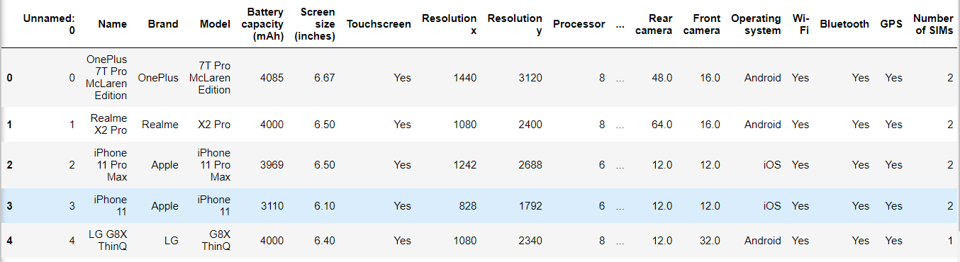
DATA DESCRIPTION
The dataset contains 21 attributes in total – 20 features and a target variable which is the price. There is a column Unnamed: 0 representing the index. The features include Name, Brand, Model, Touch Screen, Battery capacity, Resolution x, Resolution y, RAM, Screen Size, Internal Storage, Operating system, Front Camera, Rear Camera, Number of SIMs, Bluetooth, GPS, 3G, Wi-Fi, 4G/LTE. The target variable is the price.

Slide 7
DATA PREPROCESSING
Many features are important and are required to be considered to estimate the price of a smartphone. For example Processor of the mobile, Battery capacity, etc. Internal memory, Camera pixels, Size and thickness of the mobile are few of the important decision factors.
Data Integration
Importing Libraries
Creating DataFrame
Data Cleaning
Feature Engineering
Handling Outliers
Label Encoding

Slide 8
DATA PREPROCESSING
Data Integration
Importing Libraries
Creating Data Frame
Data Cleaning
Handling Missing Data
Data Transformation
Feature Engineering
Label Encoding
Handling Outliers

Slide 9

Feature engineering
The dataset has features representing the screen resolution of the smartphone namely Resolution x and Resolution y.
These two features can be combined together to create a new feature Pixels per inch which represents the screen resolution of the smartphone.
The formula used to calculate the Pixels per inch (ppi) is shown below:
where pixel density is the ppi, width is the Resolution y in pixels, length is the Resolution x in pixels and screen size (diagonal) is in inches.

Slide 10
MODEL DEVELOPMENT
This is a Regression problem as the target variable is continuous. Hence, various regression algorithms were applied to the dataset to determine the most suitable model.
The first step in creating a model is to extract the required features for training from the dataset and assigning the parameter that is to be the target variable.
The data is then portioned into two for the purpose of training the model and testing it. A test size of 0.2 implies that 80% of the data is assigned to train the prediction model and the rest is utilized to measure the quality of the developed model.
Algorithms used to develop the model
Linear Regression
Decision Tree Regressor
Random Forest Regressor
KNN
XGBoost Regressor

Slide 11
MODEL DEVELOPMENT
1. Linear Regression: The Linear Regression model was developed and evaluated using metrics such as their mean absolute error, mean absolute percentage error, mean squared error, root mean squared error, r-squared value.
2. Decision Tree: The Decision Tree Model built was tuned with the following parameters max_depth, min_samples_split, min_samples_leaf.
3. Random Forest: The Random Forest Model built was tuned with the following parameters n_estimators, max_depth, min_samples_split, min_samples_leaf, max_features, bootstrap.
4. KNN: The KNN Model built was tuned with the following parameters n_neighbors, p, algorithm.
5. XGBoost: The XGBoost Model built was tuned with the following parameters n_estimators, max_depth, max_leaves, learning_rate.

Slide 12
MODEL EVALUATION
After the Models were built, their performances were measured with their Mean Absolute Error, Mean Absolute Percentage Error, Mean Squared Error, Root Mean Squared Error, R-Squared and Accuracy score.
After evaluating the performance of all the models, it was observed that the Random Forest Regressor algorithm achieved the highest accuracy compared to the other models followed by the Decision Tree Regressor.

Slide 13
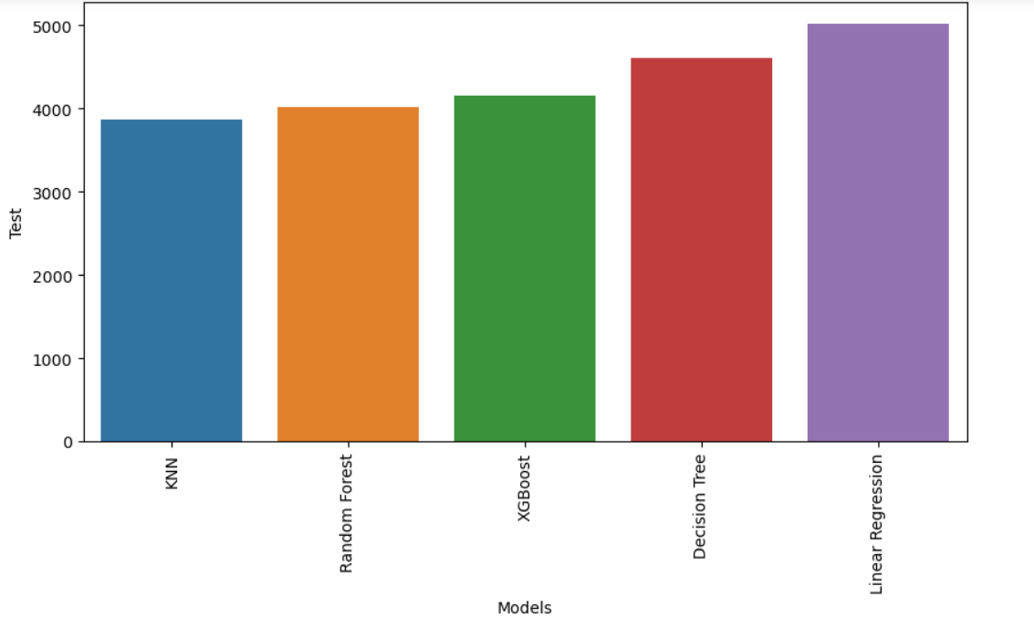
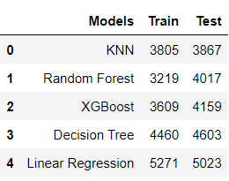
MODEL EVALUATION
Model Evaluation based on Mean Absolute Error
Amongst all the models built, the KNN has the least Mean Absolute Error followed by Random Forest Regressor and XGBoost Regressor.

Slide 14
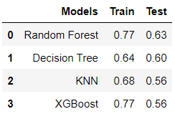
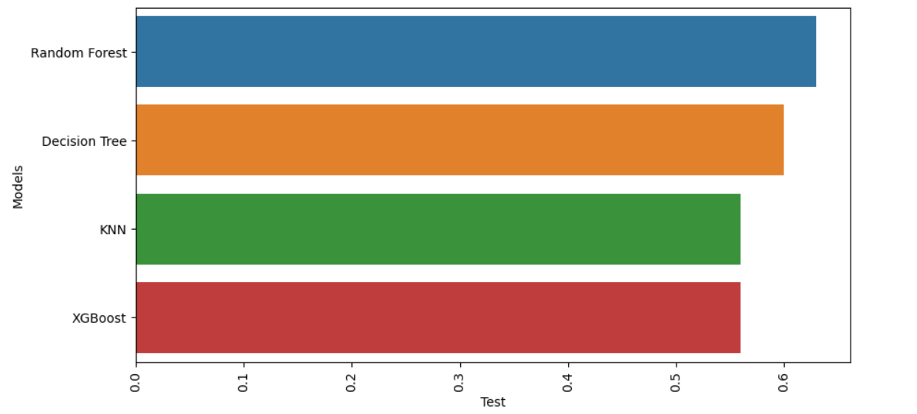
MODEL ACCURACY
Amongst all the models built the Accuracy of the Random Forest Regressor is the highest which is approximately 63%, followed by Decision Tree Regressor which is approximately 60%. The accuracy of KNN and XGBoost Regressor are approximately the same.

Slide 15
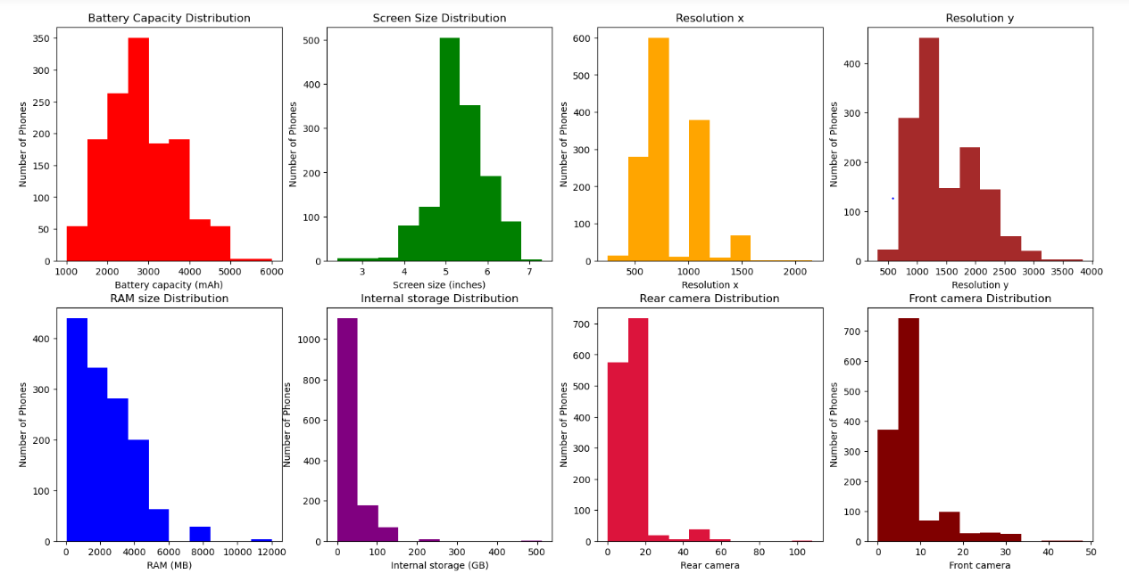
VIsuALization
1. DISTRIBUTION
Majority of the phones have a Battery Capacity between 2000-3000 mAh.
Majority of the phones have a Screen Size between 5 to 6 inches.
Majority of the phones have a Screen Size between 5 to 6 inches.
Majority of the phones have a RAM Size between 500-4000 MB.
Majority of the phones have an Internal Storage between 0.064- 64 GB.
Majority of the phones have Rear camera between 5-20 MegaPixels and Front camera between 5-10 MegaPixels.

Slide 16
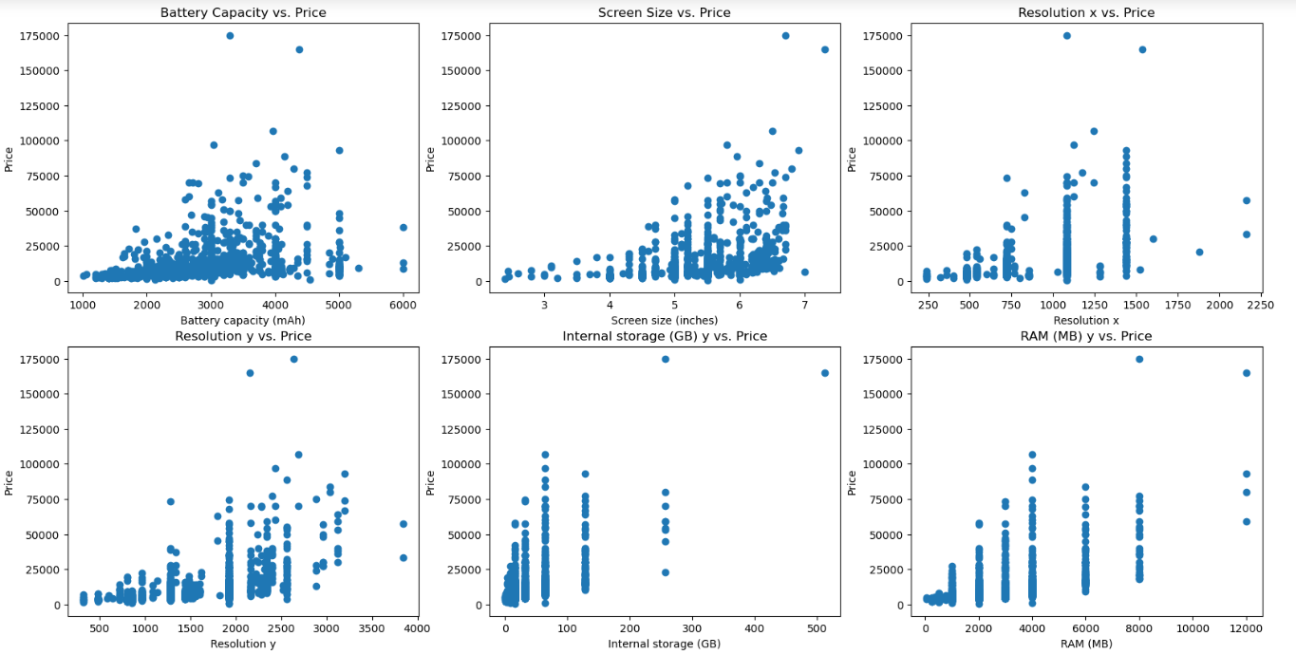
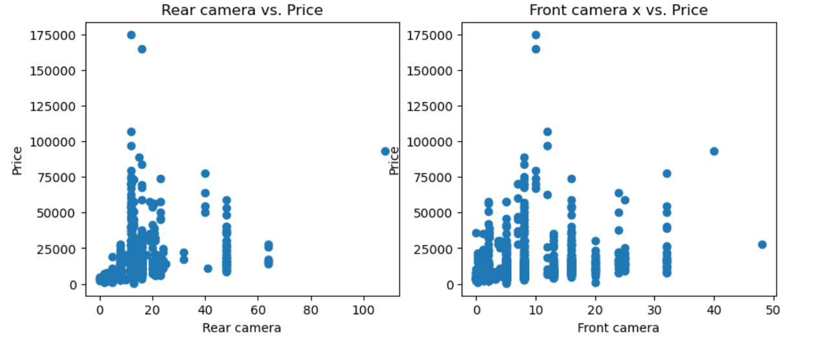
VIsuALization
2. SCATTER PLOT
Scatter Plot representing relationship between the target variable(Price) and predictor variables(Features).

Slide 17
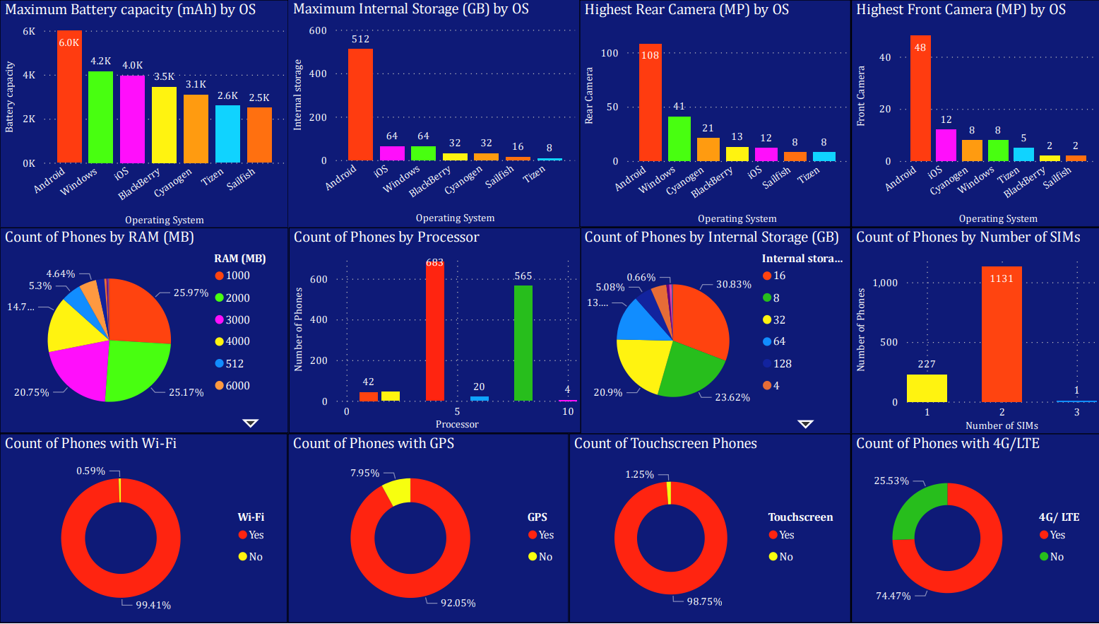
VIsuALization
Dashboard representing the maximum Battery capacity, Internal Storage, Rear Camera, Front Camera and Count of phones according to their specifications and features

Slide 18
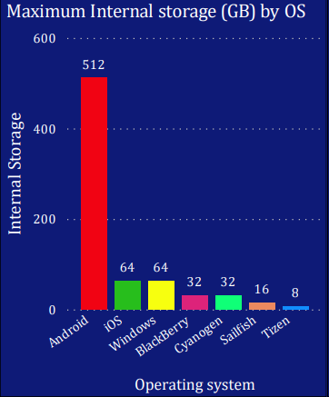
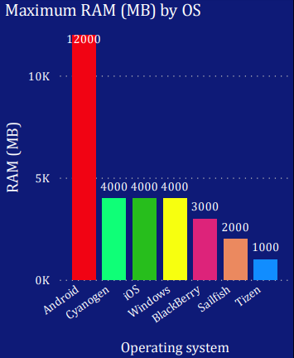
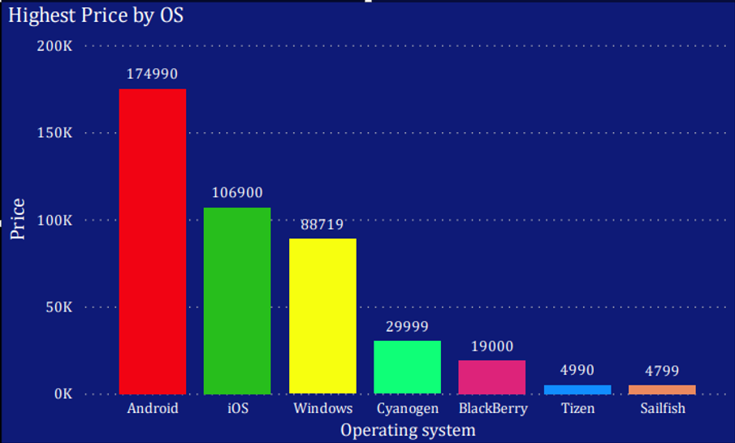
VIsuALization
Dashboard representing the highest Internal Storage, RAM size and Price categorized by the Operating system.

Slide 19
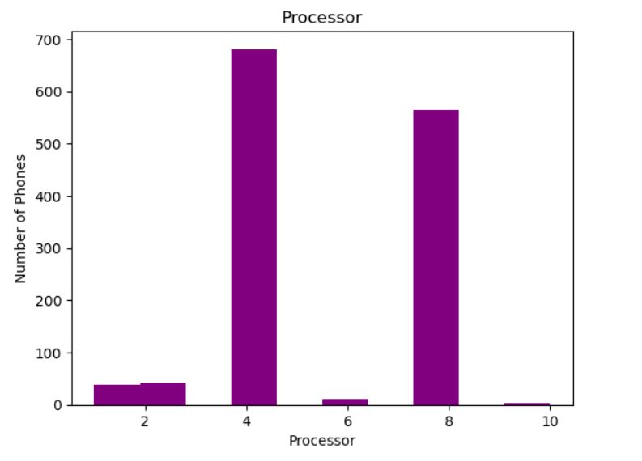
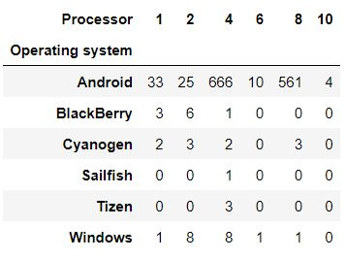
PROCESSOR
Based on the data distribution, majority of the phones have 4 Processors or 8 Processors.

Slide 20
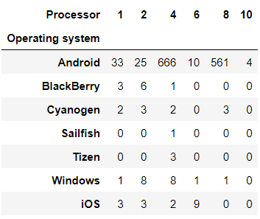
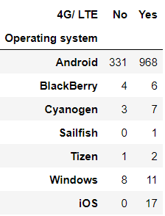
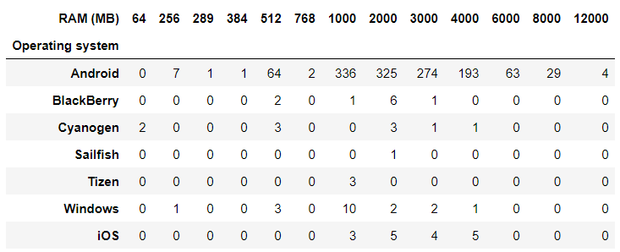
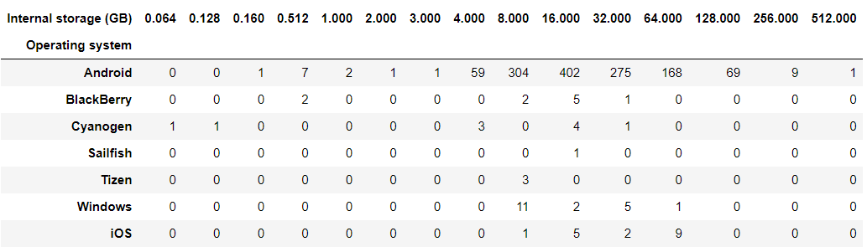
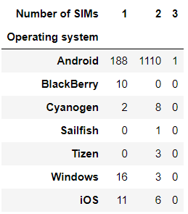
OPERATING SYSTEM
Phone Specifications according to Operating System
Processor
4G/LTE
RAM
Number of SIMs
Internal
Storage

Slide 21
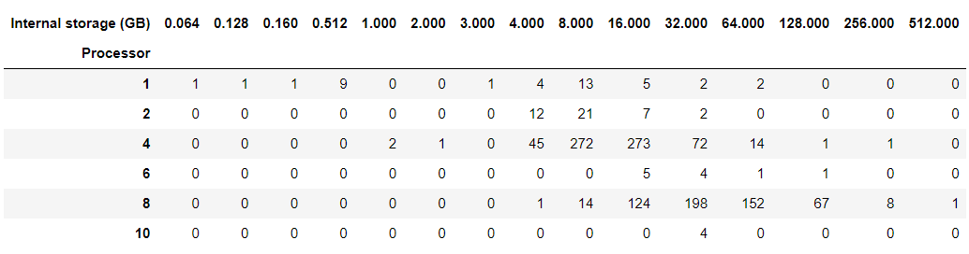
INTERNAL STORAGE & PROCESSOR
1. Phones with 4 core Processor majorly have an Internal Storage of either 8 GB or 16 GB.
2. Phones with 8 core Processor majorly have an Internal Storage of 16 GB, 32 GB or 64 GB.
3. There are few phones that come with 6 core and 10 core Processor and they have an
Internal Storage of 32 GB majorly.

Slide 22
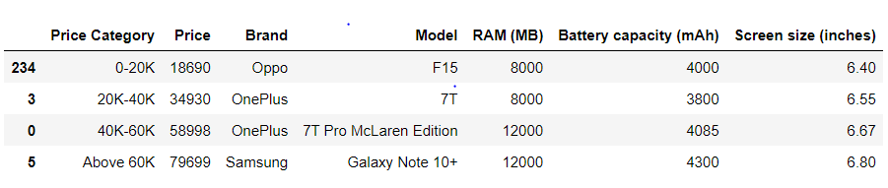
Best PHONE Based on RAM SIZE
Best Phones based on RAM size in different Price categories.

Slide 23
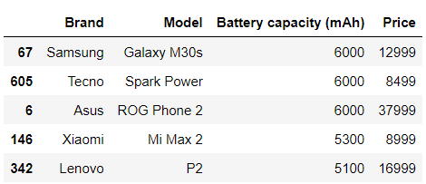
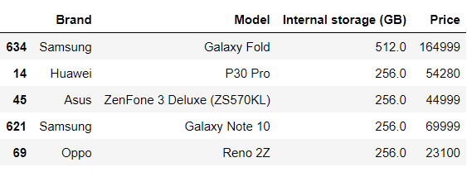
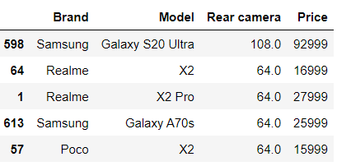
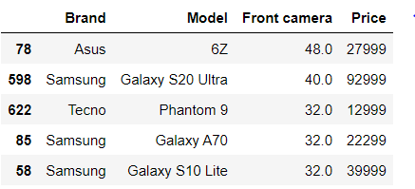
TOP PHONES BASED ON SPECIFIC FEATURES
1. Battery Capacity(mAh)
2. Internal Storage(GB)
3. Rear Camera
4. Front Camera

Slide 24
CONCLUSION
The project of smartphone price prediction was a regression problem wherein, I applied various regression algorithms to the dataset to determine the most suitable model.
After training the models using the training dataset, I performed parameter tuning for all the models and evaluated their performance using the mean absolute error, mean absolute percentage error, mean squared error, root mean squared error, r^2 and accuracy score.
After evaluating the performance of all the models, it was observed that the Random Forest Regressor algorithm achieved the highest accuracy followed by Decision Tree Regressor and KNN.

